Slide 1
Neonatal Respiratory distress
By Dr. Mohammed Abubeker
(M.D, asst. professor of pediatrics and child health)
5/8/2023

Slide 2
Outline
Approach to neonatal respiratory distress
Common cause of neonatal respiratory distress( TTN,RDS,MAS)
Less common cause of neonatal respiratory distress (congenital pneumonia, PPHN, Pulmonary Hemorrhage, Pulmonary Air Leak, congenital diaphragmatic hernia)

Slide 3
Objectives
To understand and diagnose the most common causes of respiratory distress in the newborn infant.
Recognize clinical symptoms and radiographic patterns that reflect TTN, neonatal pneumonia, RDS, and MAS.
Identify the short- and long-term complications associated with common neonatal respiratory disorders
Understand management strategies for TTN, pneumonia, RDS, and MAS.
Over view of up-to-date recommendations for the prevention of neonatal pneumonia, RDS, and MAS.

Slide 4
Approach…
One of the following is clinical criteria to say a newborn is in RD:-
  tachypnea >60 breath per minute
  severe chest indrowing
  central cyanosis
  grunting
  retraction(subcostal, intercostal, suprasternal)

Slide 5
Approach
DIAGNOSIS
  is based primarily upon the history and radiographic findings, as the physical findings are often similar among the different pulmonary conditions.
  The evolving course also helps define the specific disorder

Slide 6
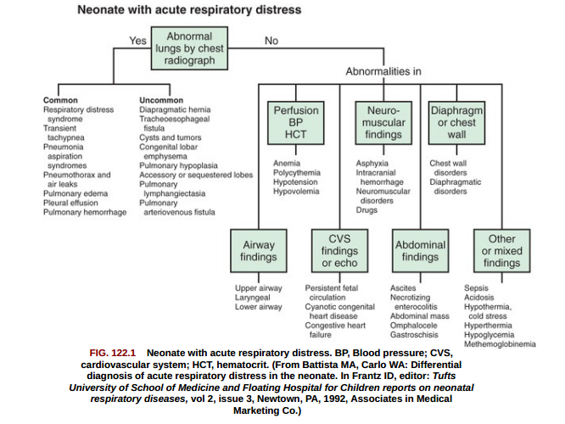
Approach…

Slide 7
Approach…
History —gestational age, method of delivery, risk of infection, and associated complications;
Transient tachypnea of the newborn (TTN)
  in the late preterm infant after caesarean delivery without labor,
  because of the failure to initiate the normal physiologic mechanisms that contribute to lung fluid clearance.
Respiratory distress syndrome (RDS) –
  in Preterm infants and the risk rises as gestational age decreases.
  in infants of diabetic mothers compared with infants of non diabetic mothers at similar gestational age.

Slide 8
Approach…
Persistent pulmonary hypertension (PPHN) - Infants born through MSAF and those who have perinatal depression.
  in infants with a history of bacterial infection, poor intrauterine growth, and NFHR patterns, suggesting poor placental function and chronic fetal hypoxemia.
  diagnosis should be confirmed by echocardiography to distinguish PPHN from structural cyanotic heart disease in term infants with severe cyanosis,

Slide 9
Approach…
Chest radiography —useful in differentiating among the disorders of neonatal respiratory distress:
TTN - usually exhibits characteristic
  Bilateral perihilar linear streaking secondary to engorged lymphatic or blood vessels.
  Patchy infiltrates that clear within 24 to 48 hours may also reflect the fluid retention of TTN, but make initial differentiation from pneumonia problematic.
  Lung ultrasound has been proposed as an imaging technique for reliable early diagnosis and differentiation of TTN
RDS- atelectasis results in the classical radiographic findings of a diffuse, reticulogranular, ground glass appearance with air bronchograms, and low lung volume.
PPHN - depends upon the presence of associated lung disease.
  In infants without lung disease, the lung fields may appear clear with decreased pulmonary vascularity. The heart size may be normal or increased.

Slide 10
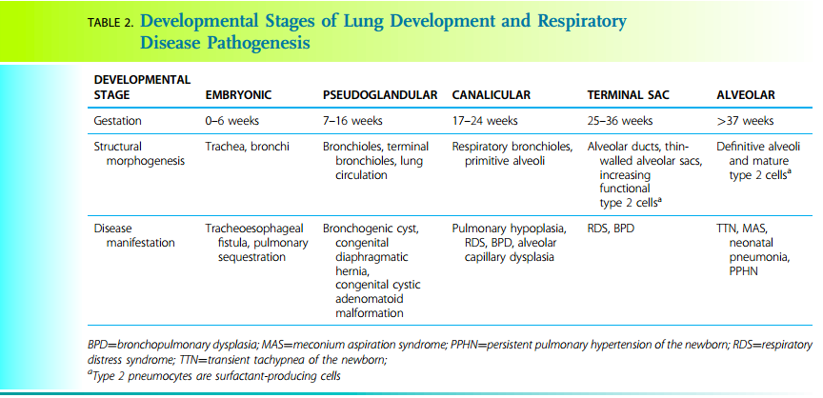
Approach…

Slide 11
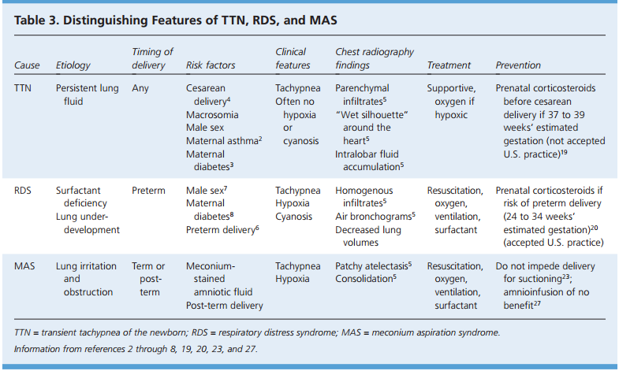
Approach….
Notes:
NB; TTN may present with cyanosis

Slide 12
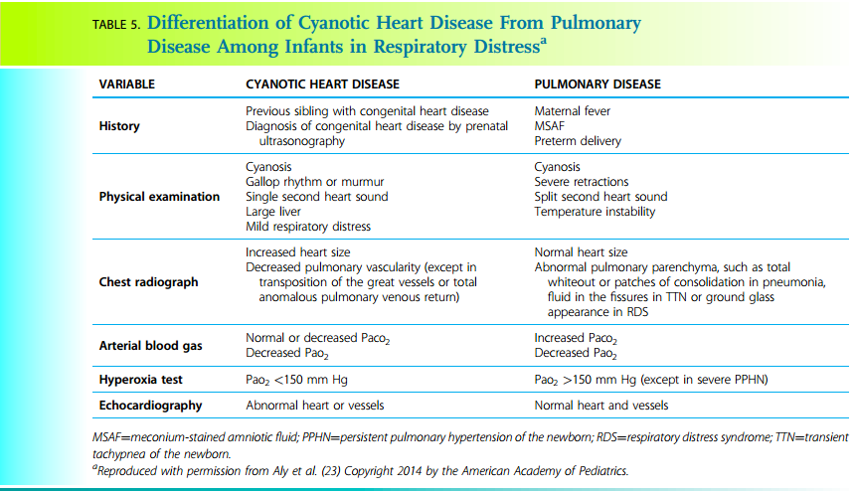
Approach…

Slide 13
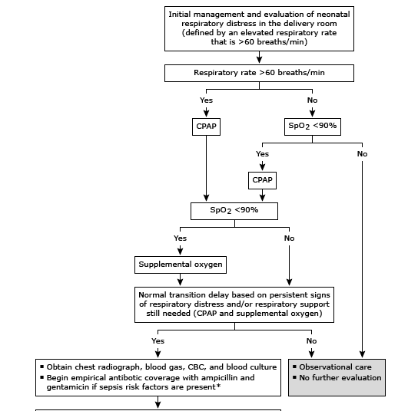
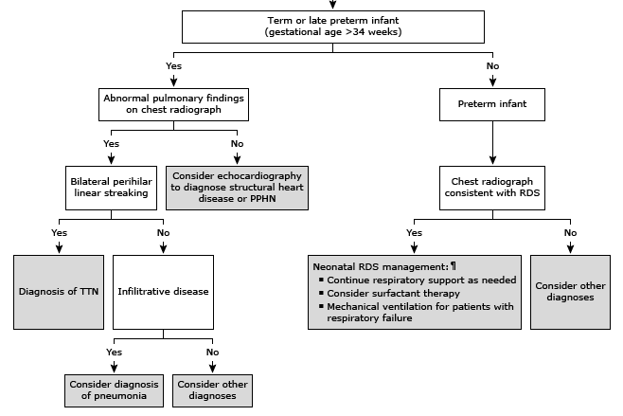
Approach …Evaluation of neonatal respiratory distress

Slide 14
Specific causes of RD
Transient tachypnea of the newborn (TTN)
Transient tachypnea of the newborn (TTN)
Results from delayed clearance of fetal lung fluid
Affects infants born at late preterm or term gestation.
Is characterized by tachypnea with signs of mild respiratory distress including retractions and cyanosis; decreased oxygen saturation is usually alleviated by supplemental oxygen with FiO2 <0.4.
Notes:
is a self-limited disorder, with symptoms resolving in 12 to 72 hours.
TTN should be a diagnosis of exclusion; it mimics the early presentation of serious respiratory, cardiac, or infectious disorders in newborns.
Management is supportive; some babies may need oxygen therapy, noninvasive
respiratory support with continuous positive airway pressure (CPAP), or nasal intermittent ventilation (NIV).
Antenatal steroids in anticipated late preterm birth ameliorate the risk of TTN.

Slide 15
TTN……
II. PATHOPHYSIOLOGY.
The lungs must switch from a secretory mode in utero to an absorptive mode.
Amiloride-sensitive sodium channels expressed in the apical membrane of the alveolar epithelium play
an important role in lung fluid clearance.
Adrenergic stimulation and other changes near birth lead to passive transport of sodium through the epithelial sodium channels
Thyroid hormone also contributes to fetal lung fluid clearance by
  increasing Na+/K+-ATPase activity and
  β-adrenergic receptor stimulation in lungs and lymphatics.
Interstitial lung fluid pools in perivascular cuffs of tissue and in the interlobar fissures and is then cleared into pulmonary capillaries and lung lymphatics.
Notes:
This transition is thought to be facilitated by changes in the maternal–fetal hormonal milieu, including a surge in glucocorticoids and catecholamines, associated with physiologic events near the end of pregnancy and during spontaneous labor.

Slide 16
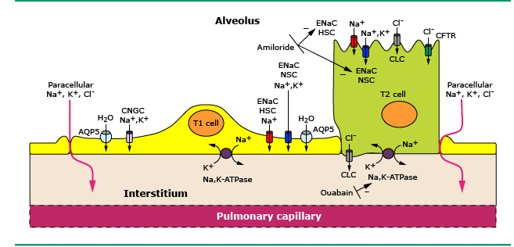
PATHOPHYSIOLOGY
Notes:
Na enters the cell through the apical surface of both ATI and ATII cells via amiloride-sensitive epithelial Na channels (ENaC), both highly selective channels (HSC) and nonselective channels (NSC), and via cyclic nucleotide gated channels (seen only in ATI cells). Electroneutrality is conserved with chloride movement through cystic fibrosis transmembrane conductance regulator (CFTR) or through chloride channels (CLC) in ATI and ATII cells, and/or paracellularly through tight junctions. The increase in cell Na stimulates Na-K-ATPase activity on the basolateral aspect of the cell membrane, which drives out three Na ions in exchange for two K ions, a process that can be blocked by the cardiac glycoside ouabain. If the net ion movement is from the apical surface to the interstitium, an osmotic gradient would be created, which would in turn direct water transport in the same direction, either through aquaporins or by diffusion.

Slide 17
PATHOPHYSIOLOGY …
Trans pulmonary hydrostatic pressure gradient created by inspiratory effort is as important as the molecular mechanisms for clearance of airway fluid.
Disruption or delay in clearance of fetal lung fluid results in the transient pulmonary edema that characterizes TTN.
Compression of the compliant airways -- airway obstruction, air trapping, and ventilation–perfusion mismatch.
Functional residual capacity may be reduced due to obstruction, whereas thoracic gas volume may increase secondary to air trapping.
Decreased surfactant function and reduced nitric oxide (NO) .
Notes:
Compression of the compliant airways by fluid accumulated in the interstitium can lead to airway obstruction, air trapping, and ventilation–perfusion mismatch.

Slide 18
TTN..
III. EPIDEMIOLOGY.
The incidence of TTN is 0.3% to 0.6% of term deliveries and 1% of preterm deliveries.
Risk factors -
  Cesarean delivery with or without labor, precipitous birth, and preterm birth
  maternal hypotension during spinal anesthesia increase the risk of TTN.
  Male gender and family history of asthma (especially mother).
  Genetic polymorphisms in β-adrenergic receptors in alveolar type II cells
  Macrosomia, maternal diabetes, pregnancy-induced hypertension, and multiple gestations
Antenatal corticosteroids given to mothers at risk for late preterm births (34 to 36 weeks, 6 days) and prior to an elective cesarean section at ≥37 weeks’ gestation reduce the risk of TTN.
Onset of labor, oxytocin exposure, and term gestation provide some degree of protection.
Notes:
These conditions are thought to result in delayed or abnormal fetal lung fluid clearance due to the absence of the hormonal changes that accompany spontaneous labor. The presence of labor and the gestational age at delivery impact the risk of respiratory complications for infants delivered by
an elective cesarean section
The mechanism underlying the gender- and asthma-associated risks is unclear but may be related to altered sensitivity to catecholamines that play a role in lung fluid clearance. Genetic polymorphisms in β-adrenergic receptors in alveolar type II cells have been associated with TTN and may influence lung fluid clearance by regulating epithelial sodium channel expression as well as explain the correlation between TTN and wheezing in the first years of life.
Macrosomia, maternal diabetes, pregnancy-induced hypertension, and multiple gestations also increase the risk of TTN. The associations between TTN and other obstetric factors such as excessive maternal sedation, prolonged labor, and volume of maternal intravenous fluids have been less consistent. Antenatal corticosteroids given to mothers at risk for late preterm births (34 to 36 weeks, 6 days) and prior to an elective cesarean section at ≥37 weeks’ gestation reduce the risk of TTN.

Slide 19
TTN..
IV. CLINICAL PRESENTATION.
Tachypnea within the first 6 hours after birth
Mild to moderate respiratory distress with retractions, grunting, nasal flaring, and/or mild cyanosis that usually responds to supplemental oxygen at <0.40 FiO2.
Increased anteroposterior diameter of the chest (barrel-shaped) due to hyperinflation, which may also push down the liver and spleen, making them palpable.
Auscultation usually reveals good air entry, and crackles may or may not be appreciated.
Signs of TTN usually persist for 12 to 24hours in cases of mild disease but can last up to 72 hours in more severe cases.
Notes:
Respiratory failure and need for mechanical ventilation should trigger investigations to rule out infection, RDS, or heart disease.

Slide 20
TTN..
V. DIFFERENTIAL DIAGNOSIS.
Pneumonia/sepsis, RDS, pulmonary hypertension, Meconium aspiration
Cyanotic congenital heart disease
Congenital malformations (e.g., congenital diaphragmatic hernia, congenital pulmonary airway malformation)
Central nervous system injury (subarachnoid hemorrhage, hypoxic-ischemic encephalopathy) causing central hyperventilation
Pneumothorax
Polycythemia, and metabolic acidosis.
Notes:
Requires the exclusion of other potential etiologies for mild to moderate respiratory distress presenting in the first 6 hours of age.

Slide 21
TTN..
VI. EVALUATION
A. History and physical examination.
A careful history identifies elements such as prematurity, infectious risk factors, meconium-stained liquor.
findings on physical examination such as cardiac or neurologic abnormalities may lead to a more targeted investigation.

Slide 22
TTN..
B. Radiographic evaluation.
Prominent perihilar streaking (sunburst pattern) due to engorgement of periarterial lymphatics that participate in the clearance of alveolar fluid.
Coarse, fluffy densities may reflect alveolar edema.
Hyperaeration with widening of intercostal spaces, mild cardiomegaly, widened and fluid-filled interlobar fissure, and mild pleural effusions may also be observed.
The radiographic findings in TTN usually improve by 12 to 18 hours and resolve by 48 to 72 hours.
This rapid resolution helps distinguish the process from pneumonia and meconium aspiration.

Slide 23
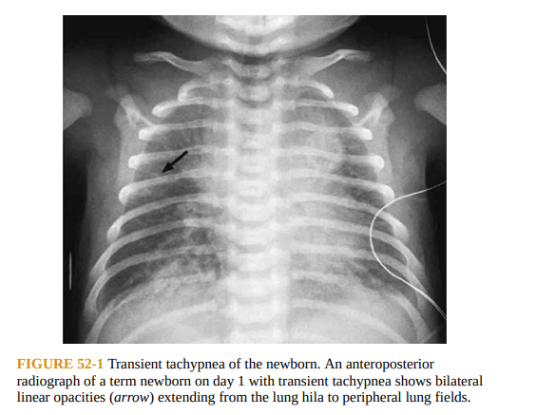

Slide 24
TTN…
Lung ultrasound (LUS) can differentiate TTN from RDS with good specificity but is not in common clinical use.
  Absence of consolidation
  Replacement of A-lines by B-lines
  Numerous compact B-lines producing “white lung,” and double-lung point (DLP) sign are findings suggestive of TTN on LUS.
Of note, the presence of increased pulmonary vascularity in the absence of cardiomegaly may represent total anomalous pulmonary venous return.

Slide 25
TTN…
C. Laboratory evaluation.
CBC and appropriate cultures can provide information concerning possible pneumonia or sepsis.
An arterial blood gas may be used to determine the extent of hypoxemia and adequacy of ventilation.
With persistent or severe hypoxemia, a cardiac evaluation should be considered.
Respiratory alkalosis may reflect central hyperventilation due to CNS pathology or metabolic disorder.
Notes:
Infants with TTN may have mild hypoxemia and mild respiratory acidosis that typically resolves over 24 hours.

Slide 26
TTN…
VII. TREATMENT.
Treatment is mainly supportive with provision of supplemental oxygen as needed.
Invasive ventilation (intubation) is rarely required
Early CPAP in the delivery room may reduce the severity and duration of respiratory distress in TTN.
IX. PROGNOSIS.
TTN is a self-limited process with no risk of recurrence, and the prognosis is excellent.
Generally, there are no significant long-term residual effects.
Notes:
Invasive ventilation (intubation) is rarely required; if respiratory distress is severe, one must investigate for and exclude serious illnesses like infection, lung malformations, inherited lung diseases (like primary ciliary dyskinesia, cystic fibrosis etc) before labeling as TTN.

Slide 27
Respiratory distress syndrome (RDS)
Occurs primarily in premature infants;
  Its incidence is inversely related to gestational age and birth weight.
  It occurs in 60– 80% of infants <28 wk GA,
  in 15–30% of those between 32 and 36 wk GA, and
  rarely in those >37 wk GA.

Slide 28
RDS…
The risk for development of RDS increases with;
  Maternal diabetes, multiple births, cesarean delivery, precipitous delivery
  Asphyxia, cold stress, and a maternal history of previously affected infants.
The risk of RDS is reduced in pregnancies with
  chronic or pregnancy-associated hypertension, maternal heroin use, prolonged rupture of membranes, and Antenatal corticosteroid prophylaxis.

Slide 29
RDS …PATHOPHYSIOLOGY
A. Lung maturity.
Factors that affect lung maturation
Maternal diabetes- enhanced production of fetal insulin which inhibits the production of surfactant phospholipids important for surfactant function.
Labor- Due to the production of endogenous maternal glucocorticoids, may enhance lung fluid clearance
Notes:
Maternal diabetes- Poorly controlled maternal diabetes is associated with RDS due to enhanced production of fetal insulin which inhibits the production of surfactant phospholipids important for surfactant function. Strict glycemic control allows the lungs to mature in a near-normal fashion.
Labor. Due to the production of endogenous maternal glucocorticoids, may enhance lung fluid clearance by enhancing sodium reabsorptive properties of epithelial sodium channels (E-NaC). Preterm babies delivered by a cesarean section before the onset of labor have a higher incidence of RDS. Preterm labor (PTL) may in some cases be due to infection; this can downregulate the production of many surfactant components.

Slide 30
RDS… PATHOPHYSIOLOGY
Mutations - specifically surfactant protein B and ABCA3, result in severe RDS typically in term infants from either dysfunctional surfactant or severely limited production, respectively.
  Infants with these mutations die without lung transplantation
Fetal sex. Male infants are at a higher risk for RDS
  due to the presence of circulating weak fetal androgens that inhibit the production of surfactant phospholipids.
Race. Infants of African ancestry are at a lower risk for developing RDS,
  due in part to the increased presence of protective genetic polymorphisms.
Notes:
Mutations in surfactant-related proteins, specifically surfactant protein B and ABCA3, result in severe RDS typically in term infants from either dysfunctional surfactant or severely limited production, respectively. Infants with these mutations die without lung transplantation. Some mutations in ABCA3 and mutations of surfactant protein C are associated with progressive interstitial lung disease, often diagnosed beyond the neonatal period.
Fetal sex. Male infants are at a higher risk for RDS due to the presence of circulating weak fetal androgens that inhibit the production of surfactant phospholipids.
Race. Infants of African ancestry are at a lower risk for developing RDS, due in part to the increased presence of protective genetic polymorphisms.

Slide 31
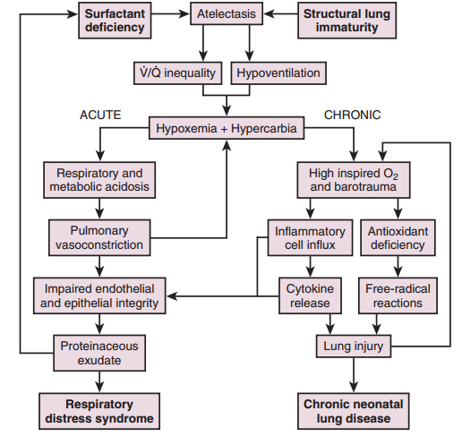
RDS… PATHOPHYSIOLOGY
Notes:
Schematic representation of the complex series of acute and chronic events that lead to neonatal respiratory distress syndrome and the accompanying lung injury secondary to therapeutic intervention in these infants.

Slide 32
RDS…pathophysiology
  Decreased surfactant production
  Presence of hyaline membranes located at junction of dilated respiratory bronchioles and dilated alveolar ducts
  Hyaline membranes contain cellular debris from injured epithelium and fibrinous matrix components
  Minimally aerated lungs, diffuse alveolar atelectasis
  Alveolar atelectasis, hyaline membrane formation, and interstitial edema make the lungs less compliant in RDS, so greater pressure is required to expand the alveoli and small airways.

Slide 33
Surfactant deficiency
high surface tension leading to instability of the lung at end-expiration, low lung volume, and decreased compliance.
  hypoxemia due to a mismatch between ventilation and perfusion
leads to lung inflammation and respiratory epithelial injury, which may result in pulmonary edema and increased airway resistance. These factors further exacerbate lung injury and worsen lung function. At the same time, abnormal fluid absorption results in inefficient clearing of liquid in the injured lung, leading to edema lung that also impedes gas exchange.
Notes:
high surface tension leading to instability of the lung at end-expiration, low lung volume, and decreased compliance. These changes in lung function cause hypoxemia due to a mismatch between ventilation and perfusion primarily due to collapse of large portions of the lung (atelectasis), with additional contributions of ventilation/perfusion mismatch from intrapulmonary and extrapulmonary right-to-left shunts. Surfactant deficiency also leads to lung inflammation and respiratory epithelial injury, which may result in pulmonary edema and increased airway resistance. These factors further exacerbate lung injury and worsen lung function. At the same time, abnormal fluid absorption results in inefficient clearing of liquid in the injured lung, leading to edema lung that also impedes gas exchange.

Slide 34
Inflammation and lung injury —
  surfactant deficiency causes atelectasis that may lead to injury of the respiratory epithelium and the alveolar capillary endothelium, which can trigger a cytokine-mediated inflammatory response.
  positive pressure ventilatory support or excessive oxidant exposure .
Lead to accumulation of protein-rich pulmonary fluid that can deactivate any surfactant that is present, thereby further exacerbating the underlying surfactant deficiency.
Notes:
Inflammation and lung injury — The role of inflammation in the pathogenesis of RDS is suggested by animal experiments in which surfactant deficiency was associated with the rapid accumulation of neutrophils in the lung and evidence of pulmonary edema [17]. In this model, depletion of neutrophils prevented pulmonary edema. In addition, as noted above, surfactant deficiency causes atelectasis that may lead to injury of the respiratory epithelium and the alveolar capillary endothelium, which can trigger a cytokine-mediated inflammatory response. Further injury may be caused by positive pressure ventilatory support or excessive oxidant exposure [18-23]. The inflammation and lung injury may, in turn, lead to accumulation of protein-rich pulmonary fluid that can deactivate any surfactant that is present, thereby further exacerbating the underlying surfactant deficiency [24].

Slide 35
Pulmonary edema — occurs because of the following contributory factors:
  Inflammation and lung injury.
  Reduced pulmonary fluid absorption − In preterm infants, an inadequate number of ENaC may result in fluid retention
  Low urine output − contributing to fluid retention in the first few days, which may exacerbate pulmonary edema.
    Infants recovering from RDS typically have a spontaneous diuresis on the second to fourth day, followed by improved pulmonary function.
Notes:
Reduced pulmonary fluid absorption − In the fetus, lung fluid is actively transported into the potential airspaces in a process mediated by chloride channels. In preparation for birth and air-breathing, the lung shifts from a secretory to an absorptive mode. Fluid absorption is mediated by sodium channels expressed on epithelial cells (ENaC). However, ENaC expression increases with gestational age in parallel with the surge in surfactant production. In preterm infants, an inadequate number of ENaC may result in fluid retention, similar to what is seen in infants with transient tachypnea of the newborn [25,26].

Slide 36
Surfactant inactivation
  Meconium and blood in the alveoli
  Proteinaceous edema and inflammatory products
Pulmonary function and gas exchange
  low compliance and low lung volume (functional residual capacity)

Slide 37
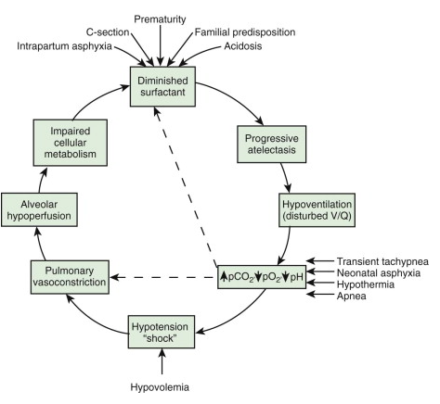
RDS…pathophysiology (contributing factors)

Slide 38
DIAGNOSIS
Antenatal testing
  Invasive testing (amniocentesis) is not done nowadays
  Lecithin/sphingomyelin (L/S) ratio and the presence of lamellar bodies in amniotic fluid were used in the past.
Clinical features.
  a preterm infant, typically <34 weeks of gestation, with signs of respiratory distress that develop soon after birth
    tachypnea, nasal flaring, subcostal and intercostal retractions, cyanosis, and an expiratory grunting
.
Notes:
signs of respiratory distress that develop soon after birth ( retractions, grunting, cyanosis, tachypnea, and flaring of the nasal alae).

Slide 39
RDS…clinical manifestations
Most infants present with SnSx either in the delivery room or within the first 6 hours after birth.
The uncomplicated clinical course is cxzed by a progressive worsening of symptoms with a peak severity by days 2 to 3 and onset of recovery by 72 hours
Blood gas measurement will demonstrate hypoxemia and hypercarbia.
  Decreased or absent air entry on auscultation

Slide 40
C/Manifestation …Physiologic maneuvers to establish FRC
  physiologic maneuvers to establish functional residual capacity (FRC) and optimize gas exchange -result in characteristic signs/symptoms of RDS.
Retractions. To maximize the negative inspiratory pressure and thus lung inflation, affected infants use accessory muscles of breathing in addition to strong diaphragmatic contractions.
Grunting - is active exhalation against a partially closed glottis and results in a pressure gradient at the level of the vocal cords that provides expiratory distending pressure to stabilize patent but surfactant-poor alveoli.
Hypoxia. Need to give more oxygen (higher FiO2) is the simplest marker of severity of RDS in preterm neonates with respiratory distress.
  Most neonatologists recommend surfactant administration for preterm babies requiring 0.3 FiO2 on optimal CPAP.
Notes:
This strong negative inspiratory pressure draws in the highly compliant chest wall resulting in subcostal, intercostal, and suprasternal retractions.

Slide 41
C/Manifestation …Physiologic maneuvers to establish FRC
Tachypnea. Inadequate FRC leads to inadequate tidal volumes. To maintain minute ventilation (the product of tidal volume and respiratory rate), infants with RDS increase the respiratory rate.
Flaring of the alae nasi. Flaring of the alae nasi reduces the resistance to air flow through the upper airways.
Silverman–Andersen Score - is a useful clinical severity grading score.
  Higher the score (≥5), more is the work of breathing and higher the need for respiratory support to improve FRC.

Slide 42
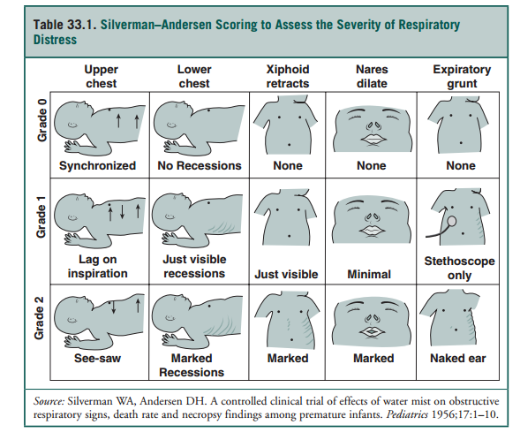

Slide 43
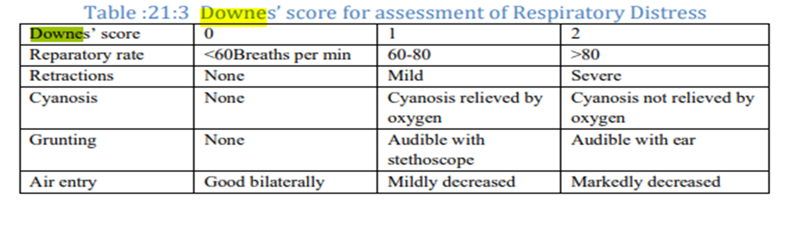

Slide 44
Investigation X-RAY
C . Radiographic evidence.
  Typical radiographic findings result from homogeneous atelectasis of alveoli (homogenous white lung) with contrast “black” bronchi that do not collapse (air bronchograms: black bronchi stand out on the white background).
  Low lung volumes (rib spaces) are most evident before initiating CPAP/ ventilation.
  In severe RDS, the cardiac border and diaphragm border are not visible; the airless “white lung” merges with the “white” heart and liver shadows.

Slide 45
Investigation X-RAY …
X-RAY PRESENTATION
The four characteristic features of the x-ray presentation in RDS are:
1. Reduced lung volume
2. Air bronchograms
3. Reticulogranularity
4. Increased lung opacification

Slide 46
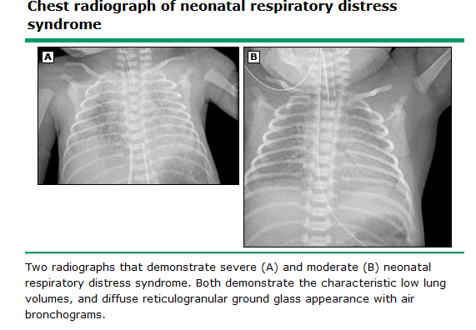
Investigation X-RAY …

Slide 47
Investigation U/S
Lung ultrasound
Differentiate RDS from transient tachypnea of the newborn (TTN) and other neonatal respiratory disorders presenting at birth.
The main findings on the lung ultrasound are;
  Consolidation with air bronchogram
  Irregular and thickened pleural line
  Compact B-lines from the base to the apex
  A-line disappearance on the transthoracic view and
  Diffuse retro diaphragmatic hyper echogenicity replacing the normal diaphragm echo complex on the trans abdominal view

Slide 48
RDS…DDX
DIFFERENTIAL DIAGNOSIS
A. Transient Tachypnea of Newborn (TTN)
B. Pneumonia.
C. Obstructed total anomalous pulmonary venous connection (TAPVC).
  a reticulogranular pattern to the lungs similar to RDS. No response to surfactant, normal-volume lungs, and 2D echo are useful in making a diagnosis
D. Genetic disorders of the surfactant system.
  Genetic mutations in surfactant protein B and ABCA3 can result in an RDS picture in the immediate newborn period.
    However, the infant shows short-lived or no response to the administration of artificial surfactant.
E. Disordered lung development.
  This category includes alveolar capillary dysplasia with malalignment of the pulmonary veins, congenital alveolar dysplasia, and brain–heart–lung disease due to mutations in NKX2.1/TTF1
Notes:
The venous congestion of the lungs gives a reticulogranular pattern to the lungs similar to RDS. No response to surfactant, normal-volume lungs, and 2D echo are useful in making a diagnosis

Slide 49
RDS…
PREVENTION
ANS for pregnant women at 24 to 34 weeks of gestation with preterm labor (PTL) or planned preterm delivery.
A complete course of ANS is considered to be
  Betamethasone at 12 mg intramuscular (IM) q24h × 2 doses OR
  Dexamethasone 6 mg IM q12h × 4 doses,
  Course completed at least 24 hours before the delivery.
Meta-analyses have not demonstrated superiority of one drug over the other.
No contraindications exist to treatment.
ANS must be given even if delivery is imminent.
Notes:
ANS – antinatalsteroids
Animal studies have demonstrated beneficial effects on lung structure even after incomplete dosing. However, benefits of prior treatment on lung maturity may diminish if PTL stops and pregnancy continues more than a week after ANS use. A second course can be beneficial under such circumstances, but continued redosing has been associated with poor neurodevelopmental outcomes due to deleterious effects of glucocorticoids on brain development.

Slide 50
RDS..mgt
MANAGEMENT
The key principles of treatment of RDS are to establish and maintain FRC, at the earliest.
A. CPAP –
  Application of CPAP via binasal prongs, nasal mask, or face mask
  Early CPAP reduces the need to intubate and give surfactant and has potential in decreasing the incidence of bronchopulmonary dysplasia (BPD).
B. Heated humidified high-flow nasal cannula (HHHFNC).

Slide 51
RDS…mgt
C. Restore alveolar surfactant.
  1. Prophylaxis versus treatment.
  2. Surfactant preparations.
  3. Dosing and dosing interval.
    Surfactant is administered to achieve a phospholipid dose that is at least 100 mg/kg.
  4. Administration. A surfactant is typically given to infants with RDS through an endotracheal tube (ETT)
Notes:
A second and occasionally a third dose of surfactant may be given if there is ongoing evidence of RDS such as persistent high oxygen requirement and other problems have been excluded.

Slide 52
RDS…mgt
D. Ensure appropriate ventilation.
  Although poor oxygenation is the most evident feature of RDS, atelectasis also reduces CO2 gas exchange resulting in hypercarbia.
1. Mechanical ventilation
  Babies with poor respiratory effort, recurrent apnea, or severe RDS (high FiO2 need, high CO2 despite optimal CPAP and surfactant) should be identified early and supported with mechanical ventilation.

Slide 53
VII. OUTCOMES OF RDS.
  In the presurfactant era, RDS in preterm infants typically resolved at 2 to 4 days of age, often preceded by spontaneous diuresis.
  With the widespread use of ANS, early use of CPAP, and exogenous surfactant, the time course of RDS has become much shorter, often just few minutes to hours.
  In some babies, association of preterm birth with chorioamnionitis may affect the time to resolution.
  RDS in infants born at ≥32 weeks of gestational age and without other complications typically resolves fully with no long-term pulmonary sequelae.
  Infants <32 weeks of gestational age are at risk for BPD; the risk increases with decreasing gestational age

Slide 54
Meconium Aspiration
I. BACKGROUND
A. Cause.
Acute or chronic hypoxia and/or infection - passage of meconium in utero.
Gasping by the fetus or newly born infant - aspiration of amniotic fluid contaminated by meconium.
Meconium aspiration before or during birth - obstruct airways, interfere with gas exchange, and cause severe respiratory distress
Notes:
Incidence of MSAF has decreased significantly in developed countries due to better perinatal care but remains high in developingcountries. The incidence of MSAF in preterm infants is very low.

Slide 55
MAS…
B. Incidence.
MSAF complicates approximately 10% to 15% of deliveries.
Most babies with MSAF are 37 weeks or older, and many meconium-stained infants are postmature and SGA.
Approximately 3% to 4% of neonates born through MSAF develop MAS in Western countries, but a higher incidence of around 11% to 28% is reported in the developing world.
Approximately 30% to 50% of these infants require CPAP or mechanical ventilation.

Slide 56
MAS…PATHOPHYSIOLOGY
II. PATHOPHYSIOLOGY.
Meconium is a sterile, thick, black-green, odorless material that results from the accumulation of debris in the fetal intestine starting in the third month of gestation.
The components of meconium includes;
  water (72% to 80%),
  desquamated cells from the intestine and skin,gastrointestinal mucin, lanugo hair, fatty material from the vernix caseosa, amniotic fluid, intestinal secretions, blood group–specific glycoproteins, bile, and
  enzymes including phospholipase A2.

Slide 57
MAS…PATHOPHYSIOLOGY
A. Passage of meconium in utero.
MSAF occurs more commonly in term or postterm pregnancies and rarely prior to 34 weeks’ gestation.
It may result from a post-term fetus with rising motilin levels and normal gastrointestinal function, vagal stimulation produced by cord or head compression, or in utero fetal stress.
  The amniotic fluid that is thinly stained is described as watery.
  The moderately stained fluid is opaque without particles, and
  fluid with thick meconium with particles is called pea soup.
The severity of MAS appears not to be related to thickness of MSAF.

Slide 58
MAS…PATHOPHYSIOLOGY
B. Aspiration of meconium.
  In the presence of fetal stress, gasping by the fetus can result in aspiration of meconium before, during, or immediately following delivery.
  Severe MAS appears to be caused by pathologic intrauterine processes, primarily chronic hypoxia, acidosis, and infection.

Slide 59
MAS…PATHOPHYSIOLOGY
C. Effects of meconium aspiration (C/F).
  Meconium staining nails, skin, umbilical cord
  Mechanically obstructs the small airways, causes
    Increased AP diameter of the chest
    atelectasis, and a “ball valve” effect with resultant air trapping and
    possible air leak.
  leads to vasospasm, hypertrophy of the pulmonary arterial musculature, and pulmonary hypertension.
  One-third of infants with MAS develop PPHN, which contributes to the mortality
  Inhibits surfactant function- RDS.
Notes:
Several studies suggest that the enzymatic and sterol components of meconium disrupt the surfactant phospholipids and limit the ability of the surfactant to lower surface tension.
leads to vasospasm, hypertrophy of the pulmonary arterial musculature, and pulmonary hypertension that leads to extrapulmonary right-to-left shunting through the ductus arteriosus or the foramen ovale, resulting in worsened ventilation–perfusion (V/Q) mismatch and severe arterial hypoxemia.

Slide 60

MAS…PATHOPHYSIOLOGY
D. Severity.
  Mild in infants requiring <40% oxygen for <48hours and
  Moderate in infants requiring >40% oxygen for >48 hours without air leak.
  Severe in infants who require assisted ventilation and/or CPAP and is often associated with PPHN.

Slide 61
MAS…PATHOPHYSIOLOGY
E. Sequelae.
  in term infants- an increased risk of perinatal and neonatal mortality, severe acidemia, need for cesarean delivery, and adverse neurologic outcome.
  In Preterm infants - similar adverse effects as well as an increased incidence of severe intraventricular hemorrhage, cystic periventricular leukomalacia, and cerebral palsy.

Slide 62
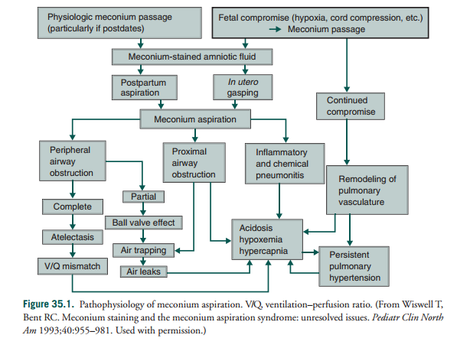
MAS…PATHOPHYSIOLOGY

Slide 63
MAS…Prevention
III. PREVENTION OF MECONIUM ASPIRATION SYNDROME
A. Prevention of the passage of meconium in utero( risk factors).
  Preeclampsia or increased blood pressure,
  Chronic respiratory or cardiovascular disease, hypertension
  heavy smokers.
  Prolonged labor
  Post maturity
  diabetes,
  Umbilical cord complications •
  Intrauterine growth retardation (IUGR).
Notes:
Amnioinfusion is associated with substantive improvements in the perinatal outcome only in settings where facilities for perinatal surveillance are limited. It is not clear whether the benefits are due to dilution of meconium or relief of oligohydramnios. In settings with standard peripartum surveillance, either amnioinfusion is ineffective or its effects are masked by other strategies to optimize neonatal outcome.

Slide 64
MAS…Prevention
B. Amnioinfusion.
  is associated with substantive improvements in the perinatal outcome only in settings where facilities for perinatal surveillance are limited.
  It is not clear whether the benefits are due to dilution of meconium or relief of oligohydramnios.
  In settings with standard peripartum surveillance, either amnioinfusion is ineffective or its effects are masked by other strategies to optimize neonatal outcome.
C. Timing and mode of delivery.
  induction as early as 41 weeks may help prevent MAS by avoiding the passage of meconium.
  The delivery mode does not appear to impact the risk of aspiration

Slide 65
MAS… mgt
IV. MANAGEMENT OF INFANTS DELIVERED THROUGH MECONIUM-STAINED
FLUID.
  vigorous - Oropharyngeal and nasopharyngeal suctioning on the perineum and routine tracheal intubation and aspiration of meconium are not effective in preventing MAS.
  Non vigorous - intubation and endotracheal suctioning for meconium previously recommended, currantly is no longer recommended.
  -intubation and suction if the airway is obstructed
  Trachial suctioning using a suction catheter inserted through the endotracheal tube
    The recommended suction pressure should be less than 80 to 100 mm Hg.
Notes:
Although intubation and endotracheal suctioning for meconium
in vigorous infants were previously recommended, evidence to support this intervention in improving respiratory and neurodevelopmental outcomes is insufficient,
and this procedure is no longer recommended. According to the 2015 Neonatal
Resuscitation Guidelines, emphasis should be placed on appropriate interventions to
support ventilation and oxygenation as needed, which may include intubation and
suction if the airway is obstructed (see Chapter 4).
If an infant does not improve with intubation and positive-pressure ventilation,
the trachea may be obstructed by thick secretions, including meconium. The trachea
should be suctioned using a suction catheter inserted through the endotracheal
tube or directly suctioned through the tube using a meconium aspirator attached

Slide 66
MAS… mgt
MANAGEMENT OF MECONIUM ASPIRATION SYNDROME
A. Observation.
Infants born through MSAF are at risk for meconium aspiration pneumonia and should be observed closely for respiratory distress.
1. A chest radiograph may help determine those infants who are most likely to develop respiratory distress,
  The classic roentgenographic findings are diffuse, asymmetric patchy infiltrates, areas of consolidation, often worse on the right, and hyperinflation.
2. Monitoring of oxygen saturation during this period aids assessment of the severity of the infant’s condition and avoids hypoxemia.
Notes:
A chest radiograph may help determine those infants who are most likely to develop respiratory distress, although a significant number of asymptomatic infants will have an abnormal-appearing chest film.

Slide 67
MAS… mgt
B. Care for neonate with meconium aspiration syndrome
1. The infant should be maintained in a neutral thermal environment, and tactile stimulation should be minimized.
2. Blood glucose and calcium levels should be assessed and corrected if necessary.
Severely depressed infants may have severe metabolic acidosis that may need to be corrected.
3. Infants may also require specific therapy for hypotension and poor cardiac output, including cardiotonic medications such as dopamine.

Slide 68
MAS… mgt
4. Circulatory support with normal saline or packed red blood cells should be provided in patients with marginal oxygenation.
  In infants with substantial oxygen and ventilator requirements, we usually maintain a hemoglobin concentration above 15 g (hematocrit above 40%).
5. Renal function should be continuously monitored
6. We avoid chest physiotherapy because of the potential adverse effect of exacerbating PPHN.
7. Airway and oral suctioning may be required to facilitate airway clearance, but
potential benefits must be balanced against the risk of hypoxic episodes and subsequent worsening of PPHN.

Slide 69
MAS… mgt
C. Oxygen therapy.
It is crucial to provide sufficient oxygen because repeated hypoxic insults may result in ongoing pulmonary vasoconstriction and contribute to the development of PPHN.
D. Assisted ventilation
1. CPAP.
  If FiO requirements exceed 0.40, a trial of CPAP may be considered.
  CPAP may sometimes aggravate air trapping and should be instituted with caution if hyperinflation is apparent clinically or radiographically.

Slide 70
MAS… mgt
2. Mechanical ventilation.
  Mechanical ventilation is indicated for excessive carbon dioxide retention (PaCO2 >60 mm Hg) or for persistent hypoxemia (PaO2 <50 mm Hg).
3. Inhaled nitric oxide (iNO) and extracorporeal membrane oxygenation (ECMO) may be required for infants with refractory respiratory failure.

Slide 71
MAS… mgt
E. Medications
1. Antibiotics.
Although few infants with MAS have documented infections, the use of broad-spectrum antibiotics (e.g., ampicillin and gentamicin) is usually indicated in infants when an infiltrate is seen on chest radiograph.
2. Surfactant.
Endogenous surfactant activity may be inhibited by meconium and is a secondary cause of surfactant deficiency.
Surfactant replacement in MAS improves oxygenation, reduces the need for ECMO, and is recommended by the Committee on Fetus and Newborn of the American Academy of Pediatrics.
3. Corticosteroids. - not routinely recommend
Notes:
Bronchoalveolar lavage with dilute surfactant might be beneficial in MAS.
But there are only a few studies, and the results are inconsistent to make a clear recommendation.

Slide 72
MAS… mgt
F. Complications
1. Air leak.
  Pneumothorax or pneumomediastinum occurs in approximately 15% to 33% of patients with MAS
2. PPHN –
  is associated with MAS in approximately one-third of cases and contributes to the mortality associated with this syndrome.
  In severely ill infants with MAS and PPHN, iNO reduces the need for ECMO.
3. Pulmonary sequelae.
  Approximately 5% of survivors require supplemental oxygen at 1 month and a substantial proportion may have an abnormal pulmonary function, including increased functional residual capacity, airway reactivity, and a higher incidence of pneumonia.
Notes:
. Air leaks occur more frequently with mechanical ventilation, especially in the setting of air trapping. A high index of suspicion for air leak is necessary.

Slide 73
Thank you

